Slide 1
Matrix Actions on Bivariate Polynomials
Michelle Bergeron
Mathematics Capstone
Advisor: John Duncan

Slide 2
Mathematical Foundations

Slide 3
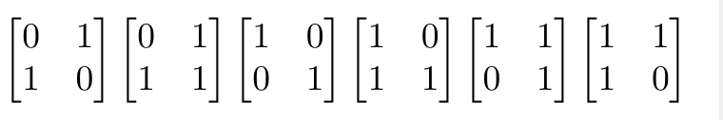
SL2 Mod (n)
Can be defined over any commutative ring with unity
All 2 x 2 matrices with determinant 1 with entries mod n

Slide 4
Polynomials with Coefficients mod n
R[x,y]n is the ring of polynomials…
Variables x and y
Coefficients in R = Z mod n
Has form ax^{n} y^{n} , a ∈ R
R[x,y]n contains n^{(k+1)} elements

Slide 5
R[x,y]2: Example
R = Integers mod 2, n = 2
Generate R[x,y]2 by plugging in elements of R:
0x2 + 0xy + 0y² = 0
1x² + 0xy + 0y2 = x²
0x² + 1xy + 0y2 = xy
0x² + 0xy + 1y2 = y²
1x² + 0xy + 1y² = x² + y²
1x² + 1xy + 0y² = x² + xy
0x² + 1xy + 1y² = xy + y²
1x² + 1xy + 1y² = x² + xy + y²

Slide 6
Matrix Actions on R[x,y]₂

Slide 7
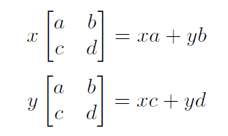
Matrix Action Definition
For a polynomial in R[x,y]n and a matrix in SL2 mod n:

Slide 8
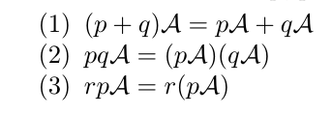
Additional Rules
For matrix action A and polynomials p and q:

Slide 9
Example in SL2 mod 2

Slide 10
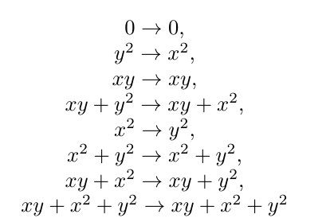
Continue for the rest of R[x, y]2…
Note that 0 and x² + xy + y² map to themselves!

Slide 11

Orbits
Every element eventually maps back to itself
Example:
y² -> x² -> y²
{x², y²} called an orbit

Slide 12
Orbits
Repeat the action on R[x, y]2 using SL2 mod 2.
We find that {0} and {x² + xy + y²} always map to themselves in SL2 mod 2!

Slide 13
Higher dimensions of R[x, y]k
We can continue this process in k = 3, 4, 5, etc.
New notation: R[x, y]k = k + 1
Continue the action on 4, 5, 6, etc…

Slide 14
Irreducibility
TODO

Slide 15
“Copies”
TODO

Slide 16
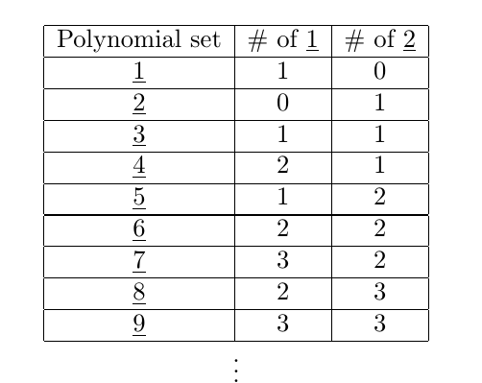
SL2 mod 2

Slide 17
SL2mod 2
Define formulas for each row in the table. For row h, take h mod 4:

Slide 18
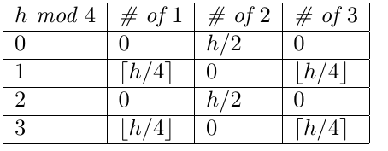
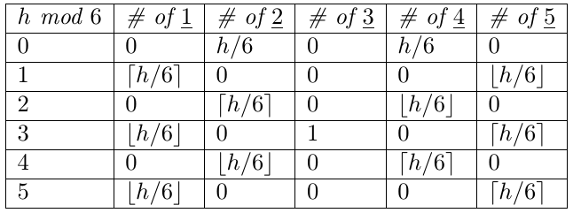
SL2 mod 3 and 5
SL2 mod 3: Take h mod 4:
SL2 mod 5: take h mod 6:

Slide 19
Generalizations in SL2 mod n
For SL2 mod n, 1…. n are irreducible!
Link between SL2 mod n and R[x, y]k
Every table has a pattern of period n+1.
Every table can be created with combinations of and the ceiling and floor of h/(n+1).

Slide 20
Future work
Future research possibilities:
Generalize a formula for any table in SL2 mod n

